Slide 1
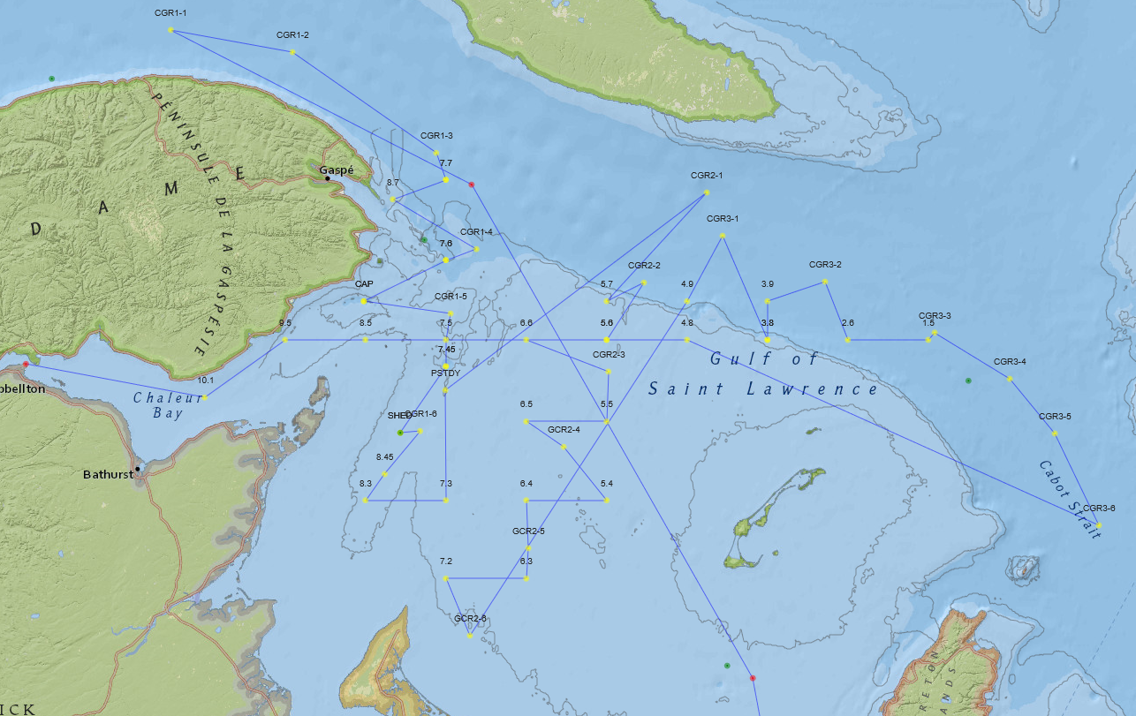
Summer 2019 Mission

Slide 2
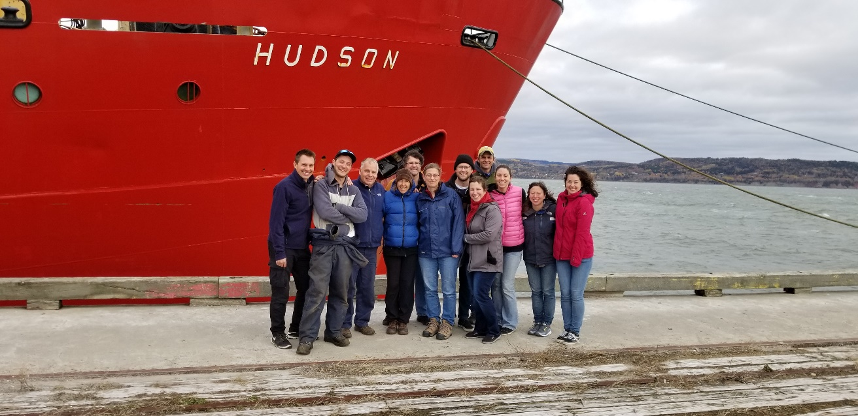
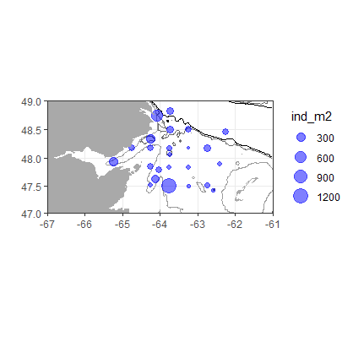
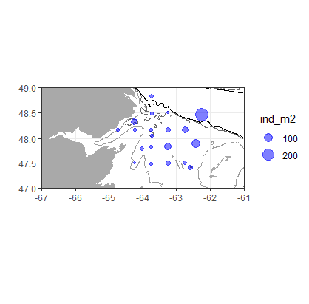
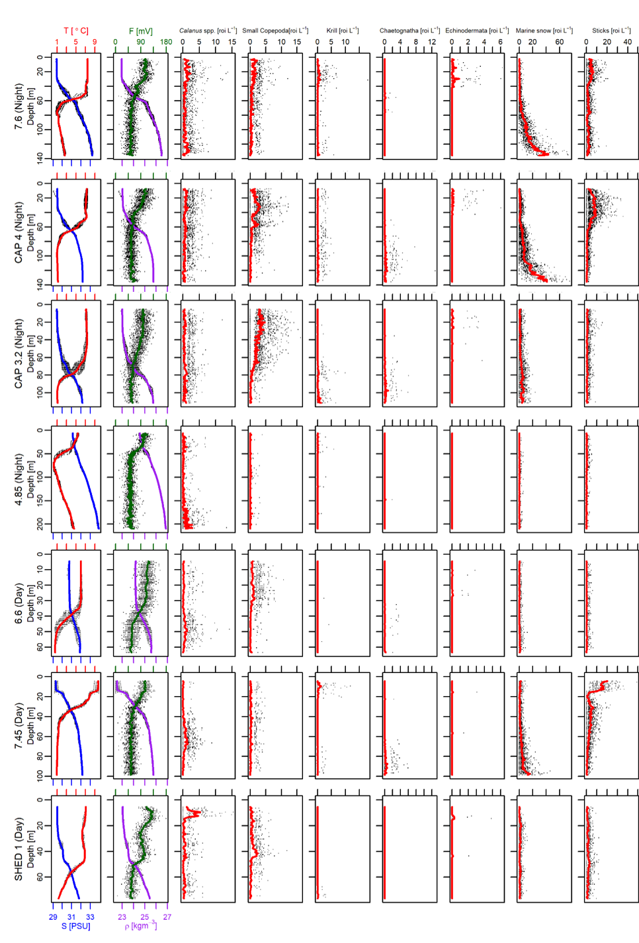
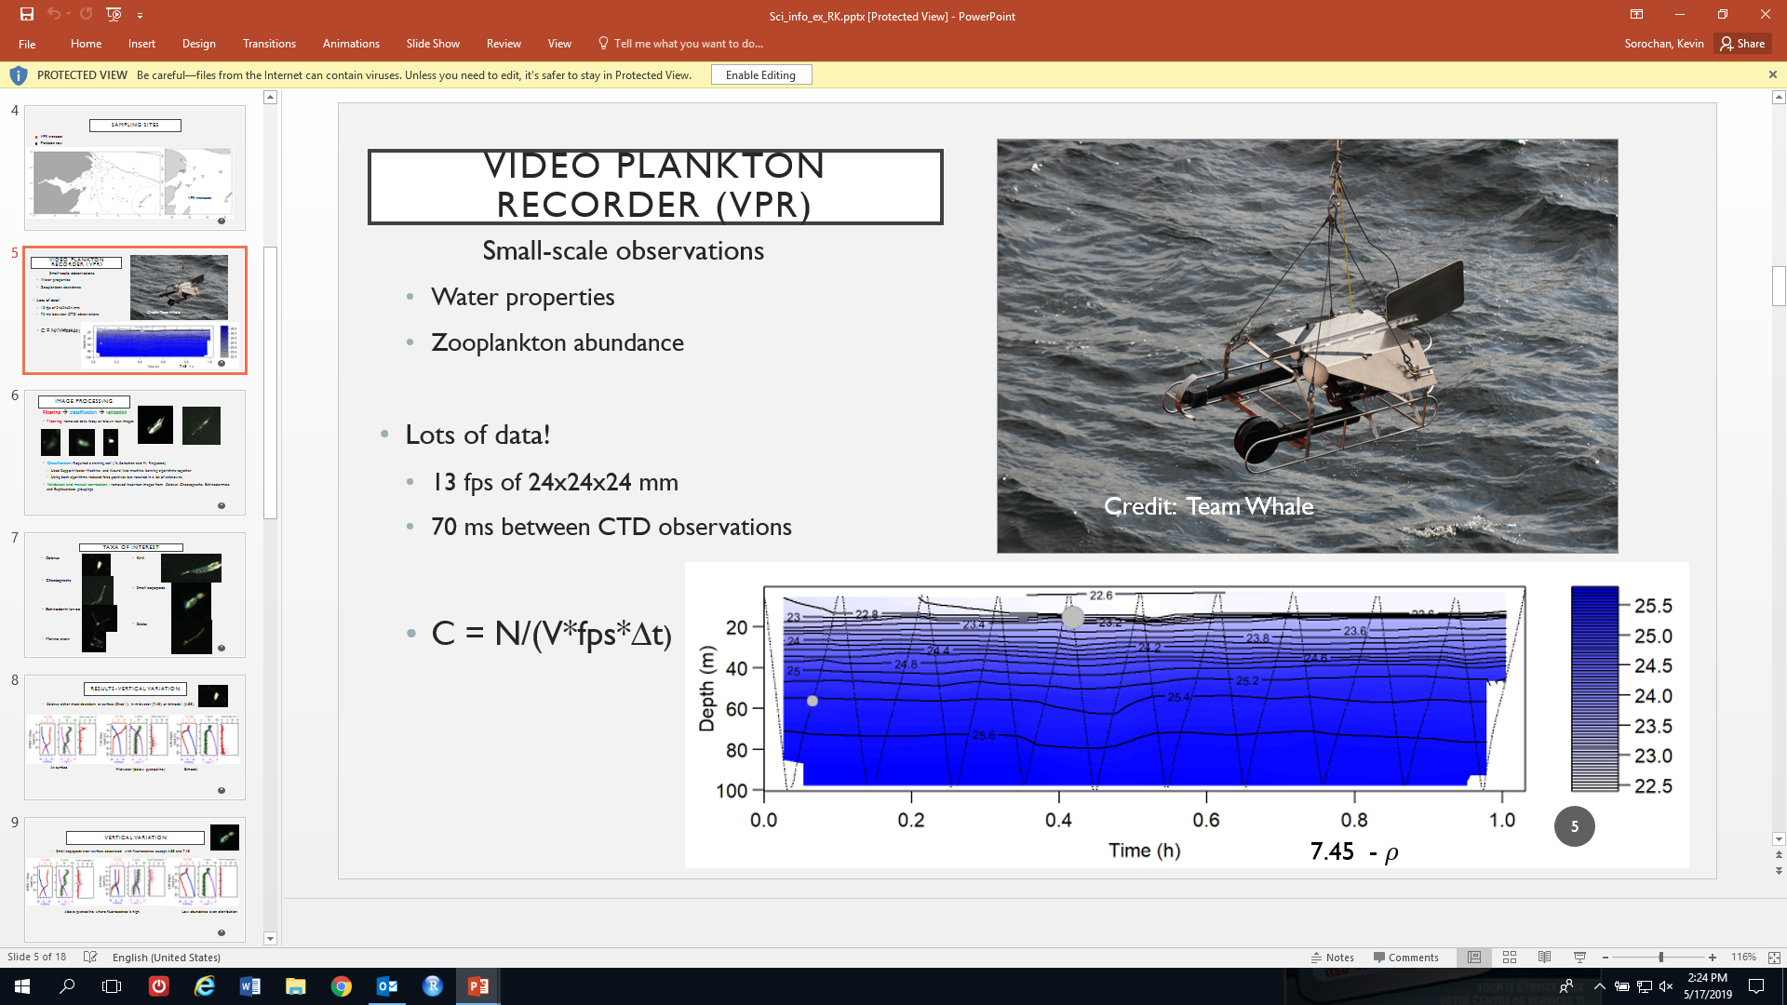
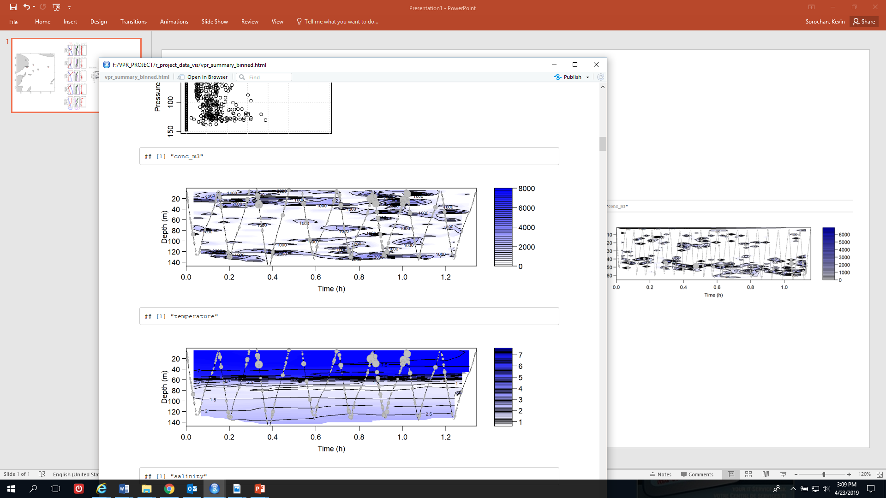
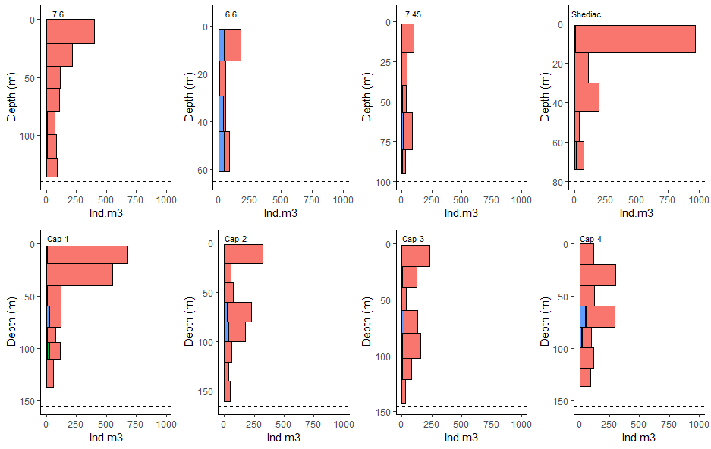

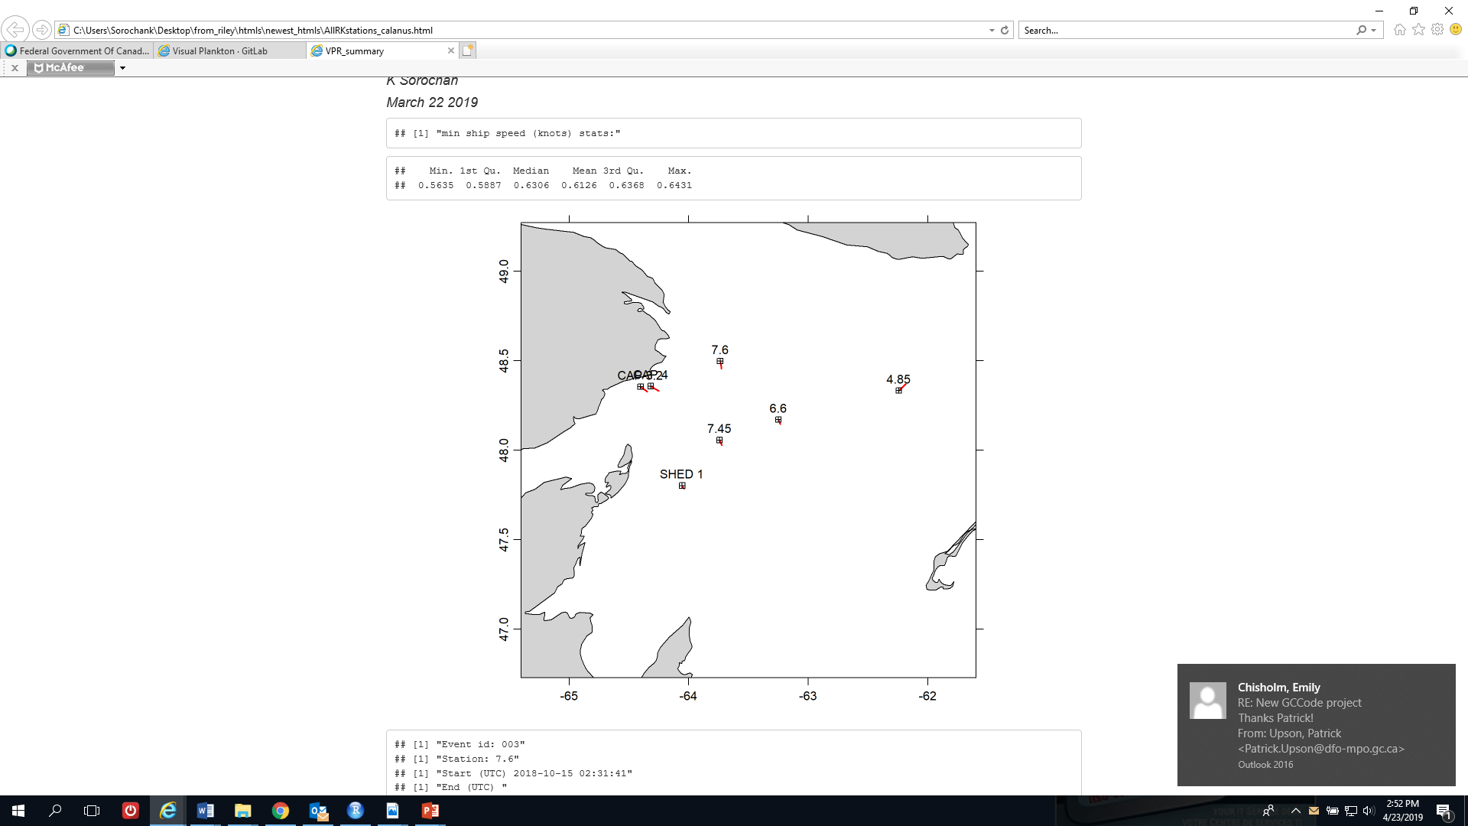
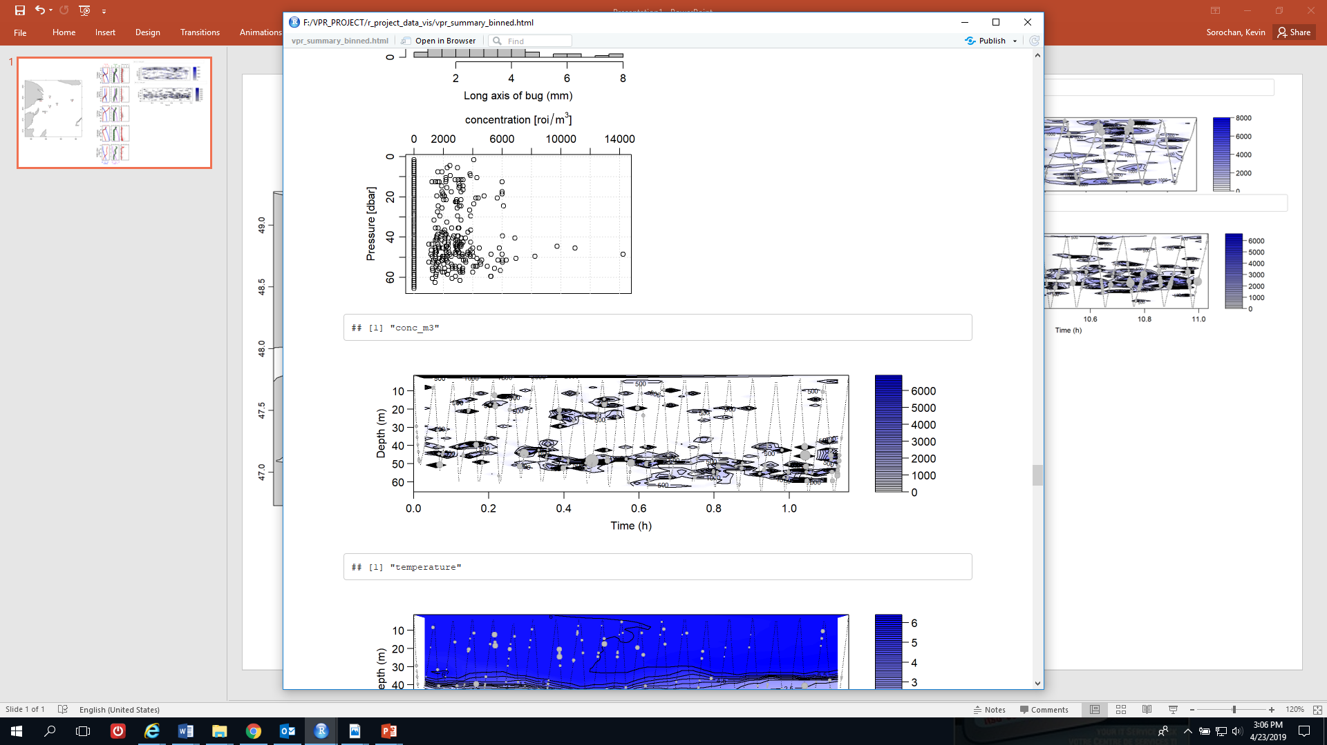
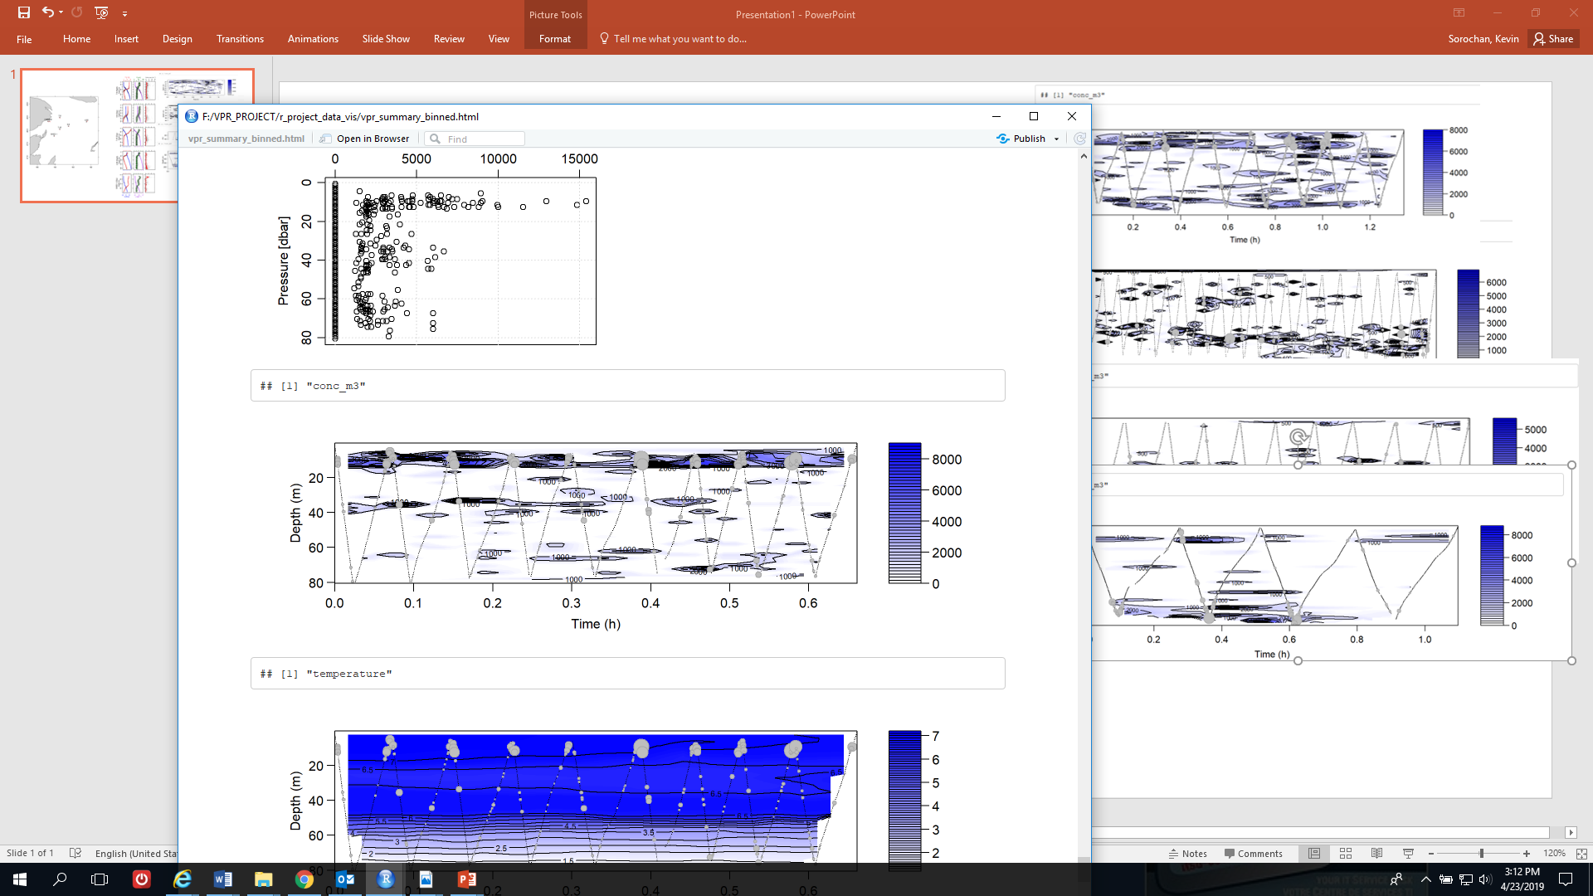
Fall 2018 Mission
JackNet survey
C. finmarchicus CIV-CVI
C. hyperboreus CIV-CVI
Ind m⁻² x 10⁻²
Ind m⁻² x 10⁻²
Video Plankton Recorder (VPR)
BIONESS
ind m⁻³
VPR transects
C. finmarchicus
C. hyperboreus
Calanus spp.

